Slide 1
Strategic management Chapter 8
Strategic Management. Fred R.David • Forest R.David. 15th ed., 2015 .Pearson Education

Slide 2

Excellent Strategic Management Showcased
Unilever
a dual listed company - Unilever
N.V. based in Rotterdam, Netherlands, and Unilever PLC based in
London – but both companies have the same directors and operate as a single business.

Slide 3
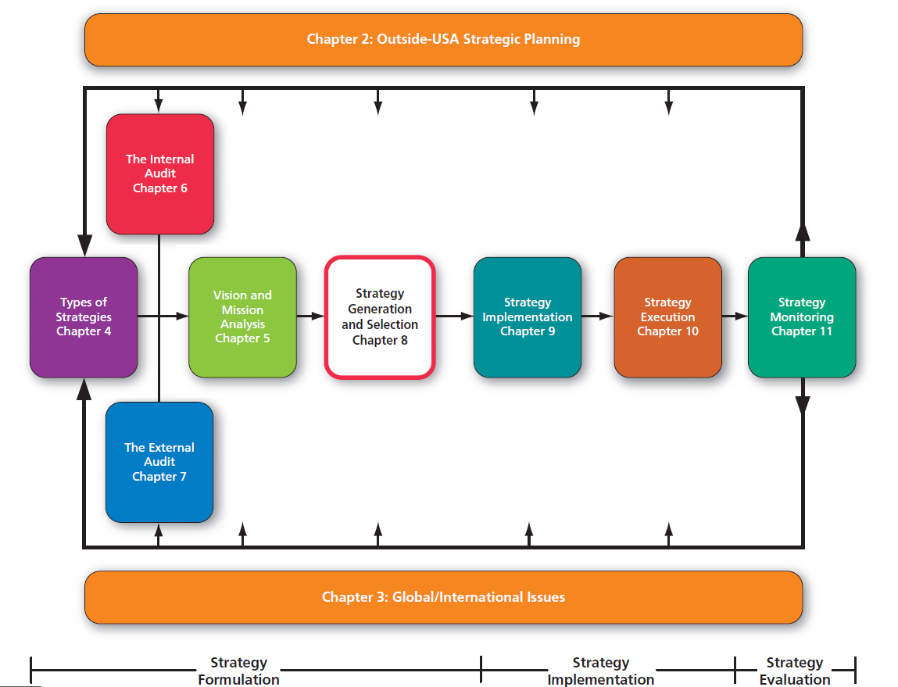

Slide 4
A Comprehensive Strategy-Formulation Analytical Framework
Stage 1input stage - the formulation framework consists of the EFE Matrix, the IFE Matrix, and the Competitive Profile Matrix (CPM).
Stage 2 Matching stage- techniques include the Strengths-Weaknesses-Opportunities-Threats (SWOT) Matrix, the Strategic Position and Action Evaluation (SPACE) Matrix, the Boston Consulting Group (BCG) Matrix, the Internal-External (IE) Matrix, and the Grand Strategy Matrix.
Stage 3, called the decision stage, involves a single technique, the Quantitative Strategic Planning Matrix (QSPM).

Slide 5

Strategy choice largely involve making subjective decisions based on objective information

Slide 6
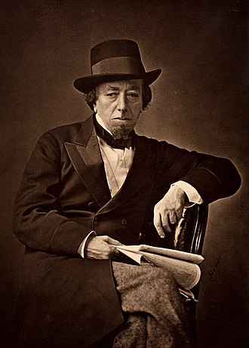
strategy-formulation framework
'There are three kinds of lies: lies, damned lies, and statistics'
Lenz emphasized that the shift from a words-oriented to a numbers oriented planning process can give rise to a false sense of certainty;
Benjamin Disraeli

Slide 7
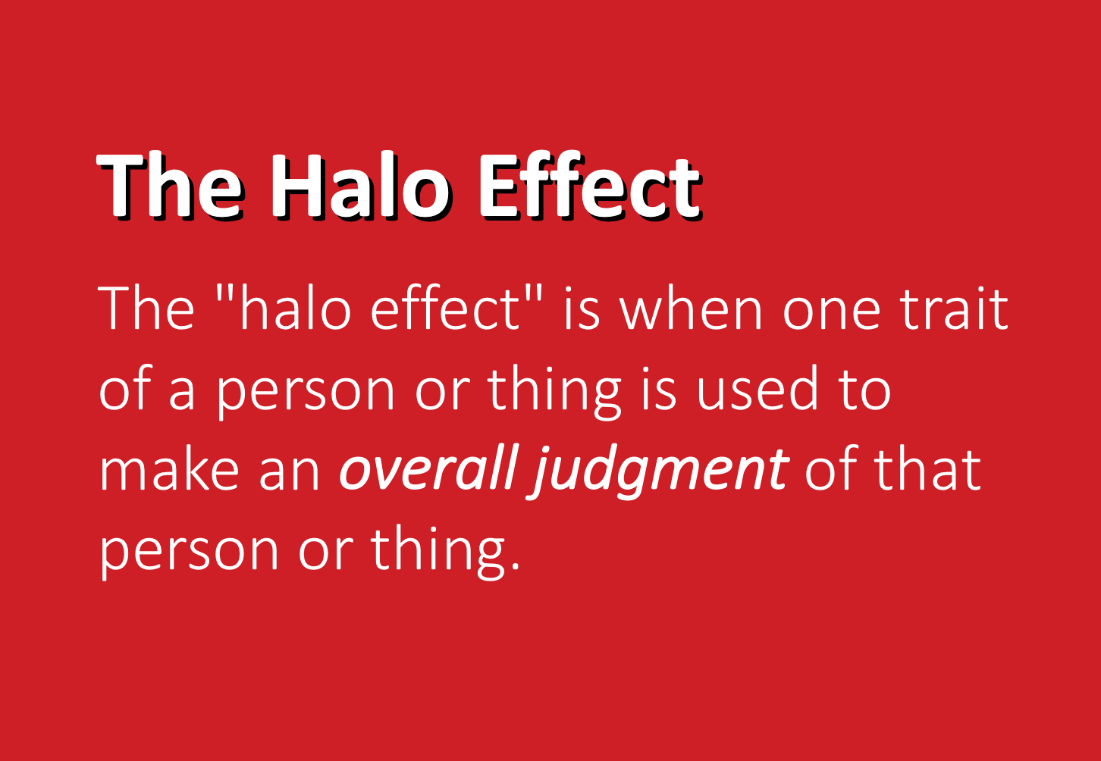
strategy-formulation framework
Without objective information and analysis, personal biases, politics, emotions, personalities, and halo error unfortunately may play a dominant role in the strategy-formulation process.
Halo error

Slide 8
Alternative strategy formulation
Identifying and evaluating alternative strategies should involve many of the managers and employees who previously assembled the organizational vision and mission statements, performed the external audit, and conducted the internal audit.
Recall that involvement provides the best opportunity for managers and employees to gain an understanding of what the firm is doing and why and to become committed to helping the firm accomplish its objectives.

Slide 9

Alternative strategies
1 = should not be implemented,
2 = possibly should be implemented,
3 = probably should be implemented,
4 = definitely should be implemented.
Ranking the proposed strategies

Slide 10
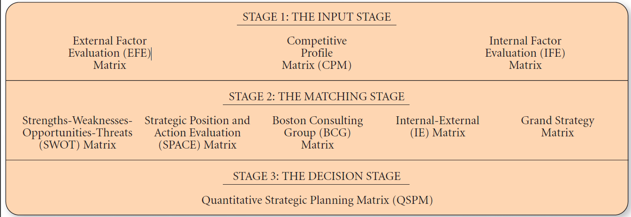
A Comprehensive Strategy-Formulation Analytical Framework
Intuition and Analysis

Slide 11
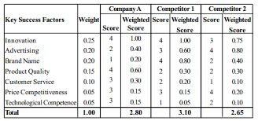
The Input Stage
External Factor Evaluation (EFE) Matrix
Competitive Profile Matrix (CPM)
Internal Factor Evaluation (IFE) Matrix
Good intuitive judgment is always needed in determining appropriate weights and ratings.

Slide 12
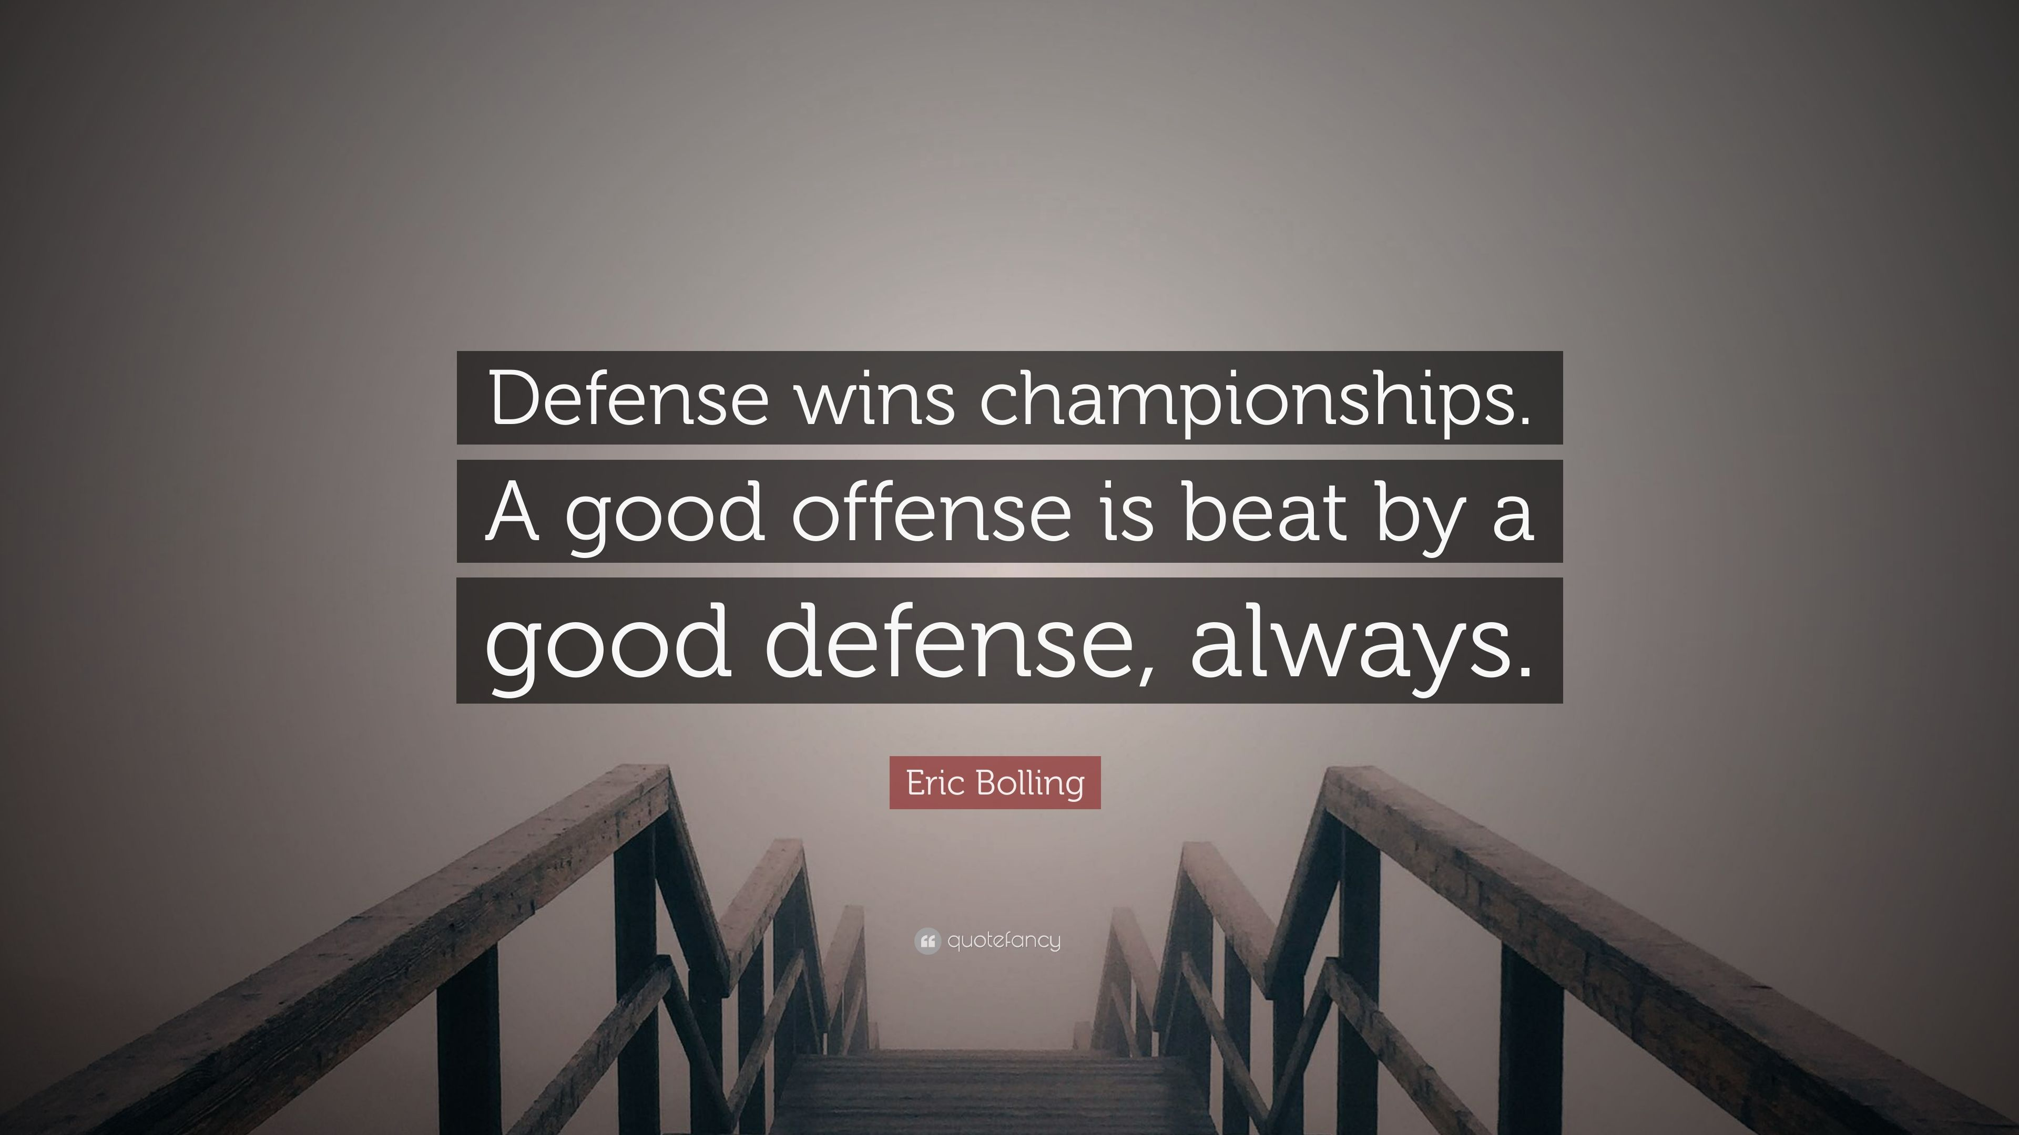
The Matching Stage
SWOT Matrix,
SPACE Matrix,
BCG Matrix,
IE Matrix,
Grand Strategy Matrix.
Matching external and internal critical success factors is the key to effectively generating feasible alternative strategies
Developing strategies that use strengths to capitalize
on opportunities could be considered an offense, whereas strategies designed to improve on weaknesses while avoiding threats could be termed defensive

Slide 13
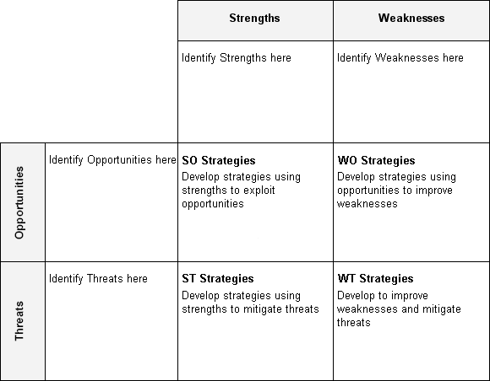
SWOT Matrix
SWOT Analyses ?

Slide 14

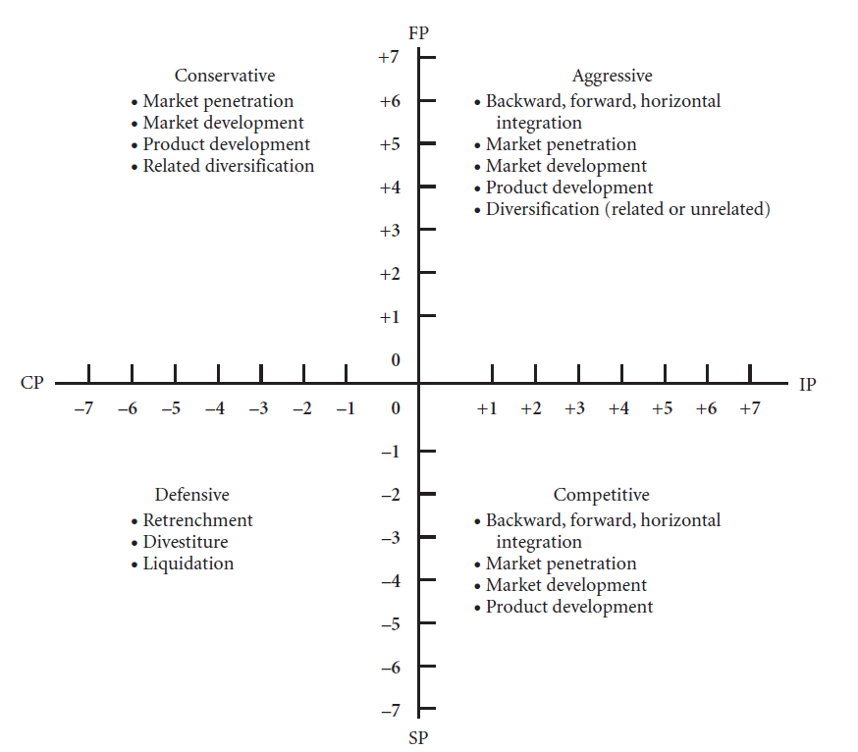



The Strategic Position and Action Evaluation (SPACE) Matrix

Slide 15
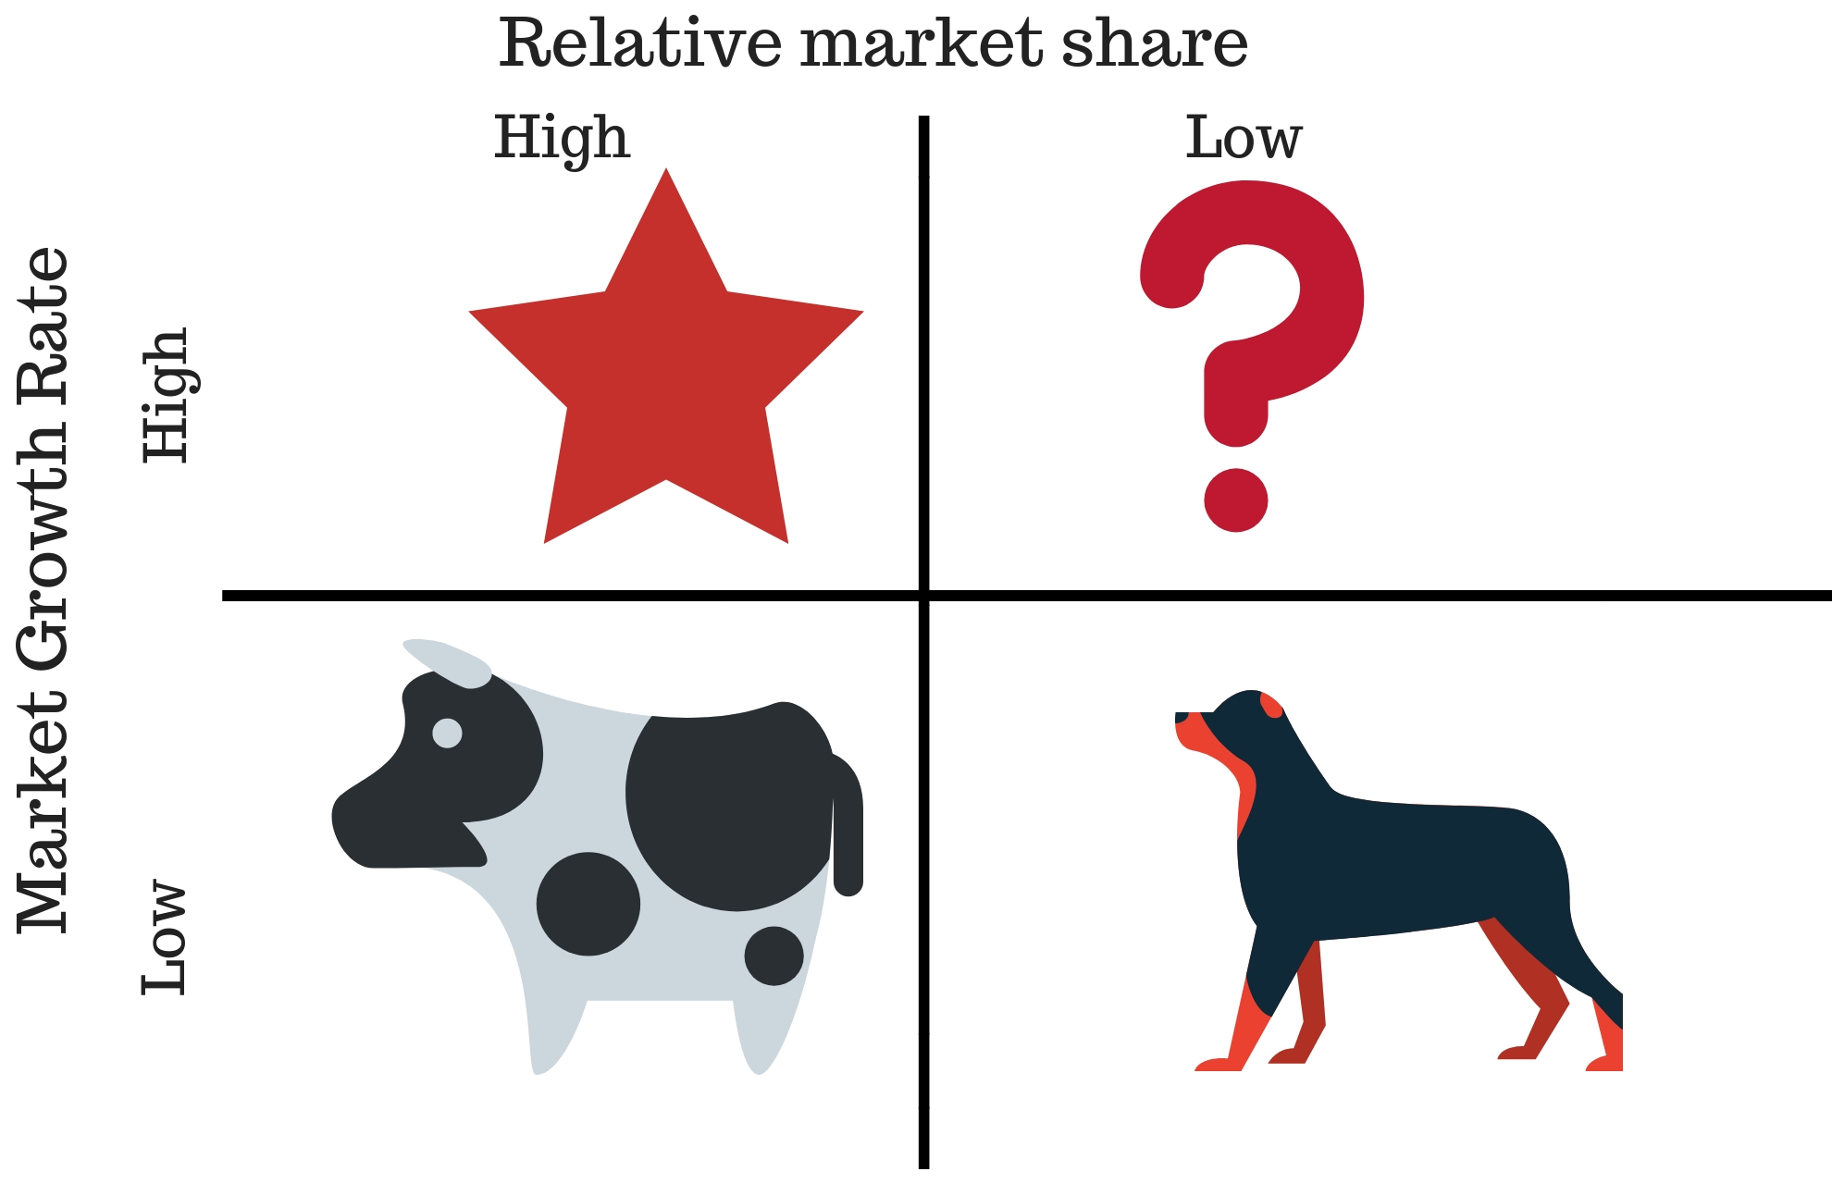
The Boston Consulting Group (BCG) Matrix
“portfolio matrices”

Slide 16
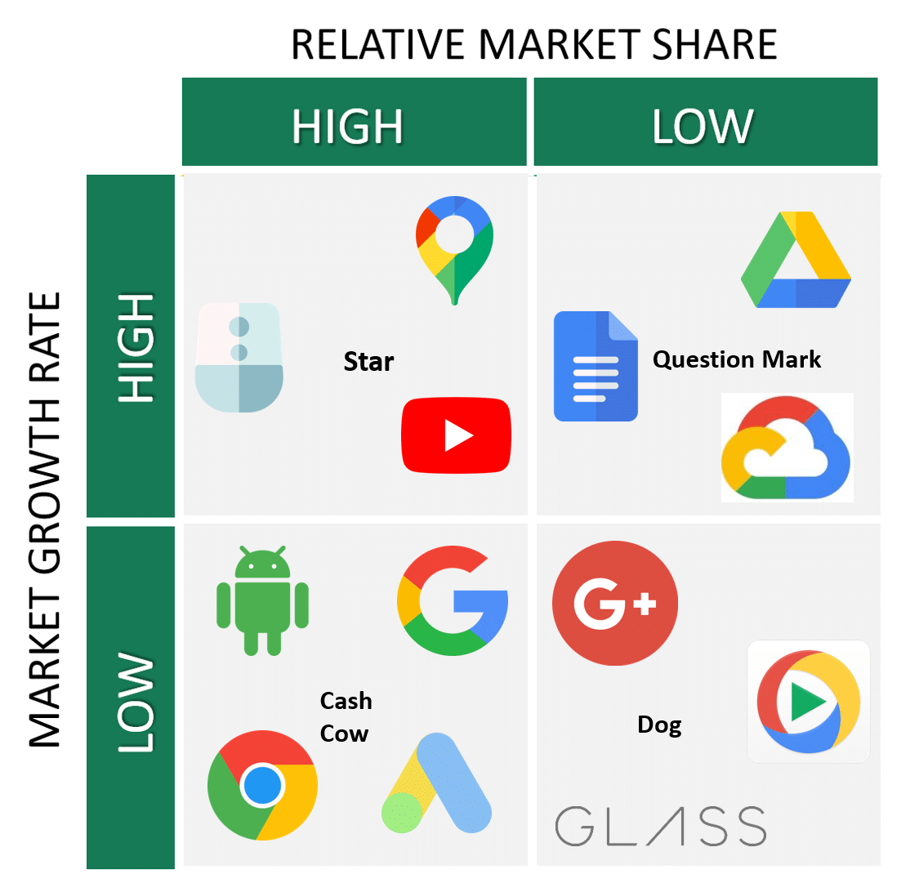
The Boston Consulting Group (BCG) Matrix

Slide 17
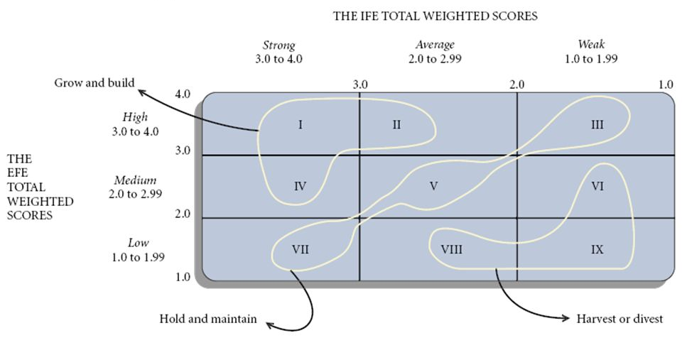
The Internal-External (IE) Matrix
“portfolio matrices”
IFE
EFE

Slide 18
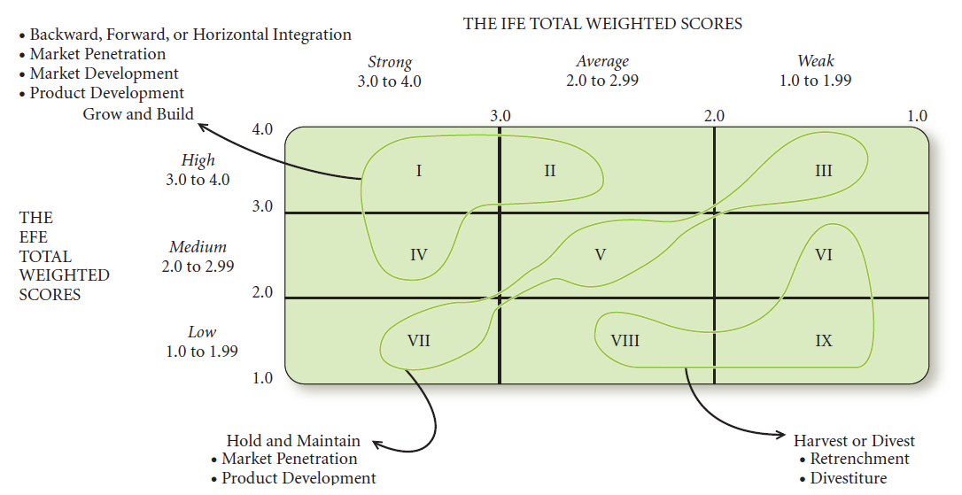
The Internal-External (IE) Matrix
IFE Matrix and an EFE
“portfolio matrices”
IFE
EFE

Slide 19
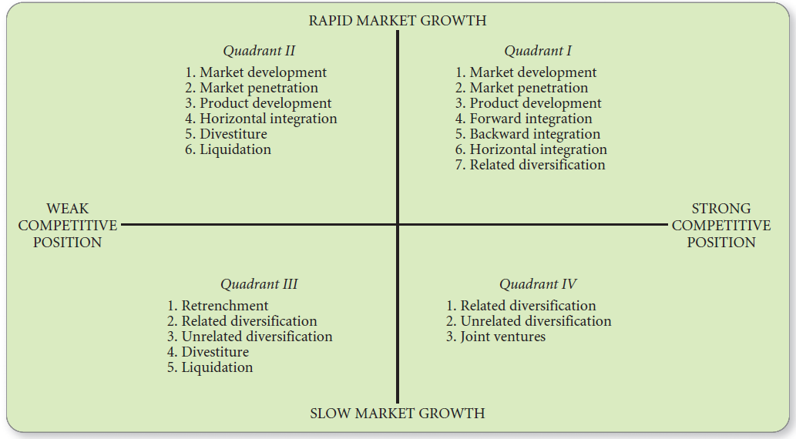
The Grand Strategy Matrix

Slide 20

The Decision Stage
The Quantitative Strategic Planning Matrix—QSPM

Slide 21
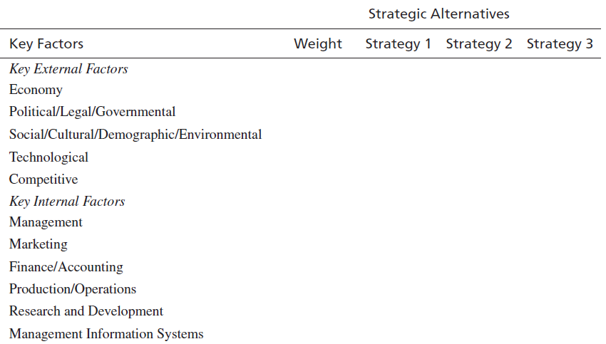
The Quantitative Strategic Planning Matrix—QSPM
“Does this factor affect the
choice of strategies being made?”
Attractiveness Score (AS)
total attractiveness scores (TAS)

Slide 22
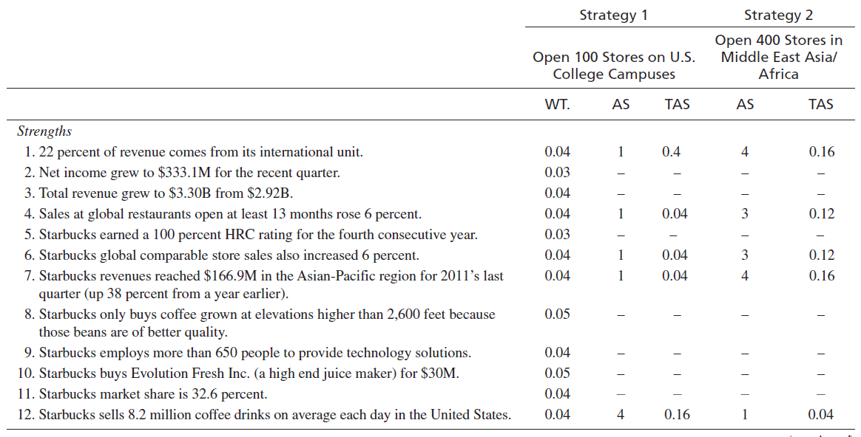
The Quantitative Strategic Planning Matrix—QSPM
Attractiveness Score

Slide 23
The Quantitative Strategic Planning Matrix—QSPM
positive feature
imitations
less likely that key factors will be overlooked or weighted inappropriately
A QSPM can be used by small and large, for-profit and nonprofit organizations.
Genuine differences of interpretation of information

Slide 24
Cultural Aspects of Strategy Choice
Culture is the unique way an organization does business
All human beings have a basic need to make sense of the world, to feel in control, and to make meaning.
Managers and employees may even sabotage new strategies in an effort to recapture the status quo.
If a firm’s strategies are supported by cultural products such as values, beliefs, rites, rituals, ceremonies, stories, symbols, language, heroes, and heroines, then managers often can implement changes swiftly and easily.

Slide 25
Developing a (SPACE Matrix) of a Georgian competitor companies
Homework
Homework should be prepared in a mini presentation format max 10 slides. Homework should be sent to my Mail till our next meeting

